Slide 1


Slide 2

Analysis of the real estate market
USING MULTIVARIATE ANALYSIS TECHNIQUES
Presented by
TAMERLAN ASSYLKHAN
KIRILL KISELEV
ALIKHAN KARIMOV

Slide 3


Slide 4

Why this dataset?
1
21,501 observations
4
10 categorical variables
Natural grouping variables (city, type) for MANOVA
2
12 continuous variables
5
Rich feature set for PCA, Factor Analysis and other methods
3
5 discrete variables
6

Slide 5
Variable Description
Key variable groups:
  Property Features: squareMeters, rooms, floor, floorCount, buildYear
Variable Type | Count | Examples
Continuous | 12 | squareMeters, price, centreDistance, schoolDistance, clinicDistance, pharmacyDistance, etc.
Discrete | 5 | rooms, floor, floorCount, buildYear, poiCount
Categorical | 10 | city (15 cities), type (3 types), ownership, condition, amenities (5 binary)
  Location/Accessibility: 8 distance variables
  Amenities: hasParkingSpace, hasBalcony, hasElevator, etc.
  Target: price (PLN)

Slide 6
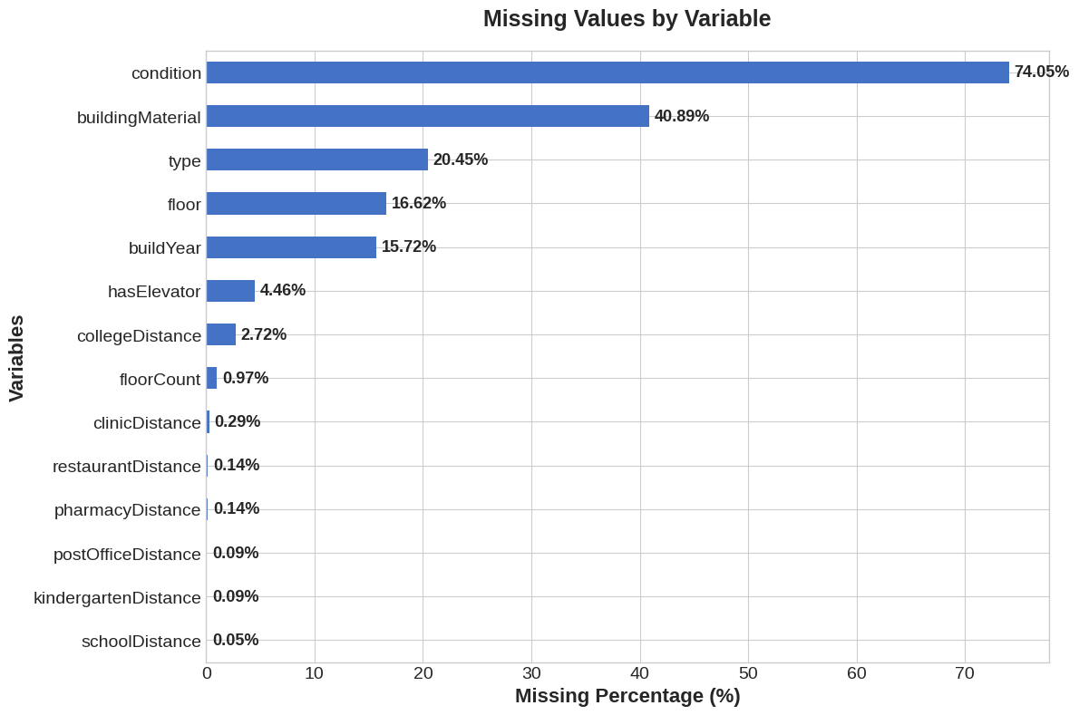
How we handled missing values?
  Continuous variables → Median imputation (robust to outliers)
  Categorical variables → Assigned "unknown" category
  No rows were removed (preserved sample size)

Slide 7
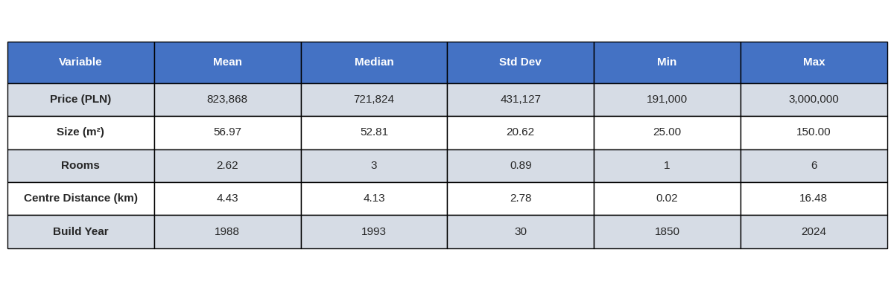
Key Statistics Summary
Key Insights:
  Right-skewed price distribution (mean > median)
  Typical apartment: ~53 m², 3 rooms, built in 1993
  Wide range of build years (1850-2024)

Slide 8
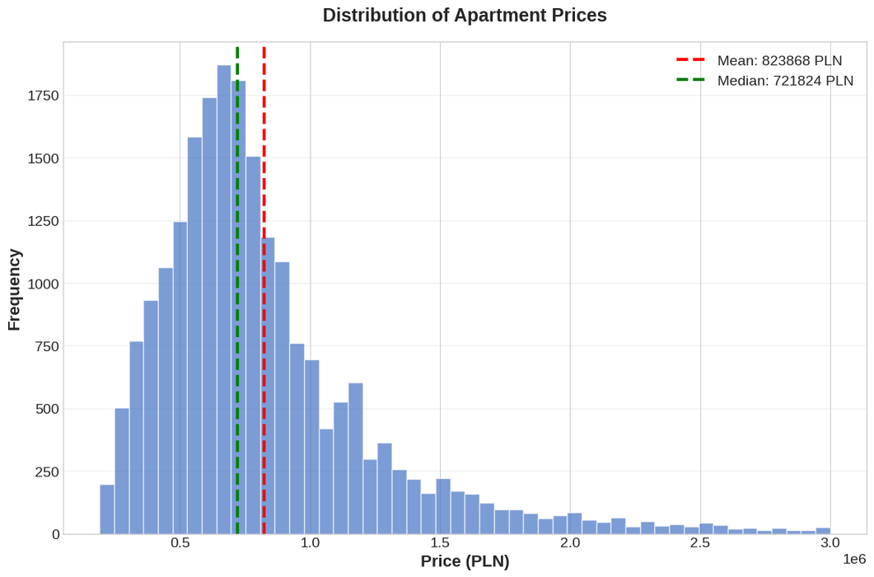
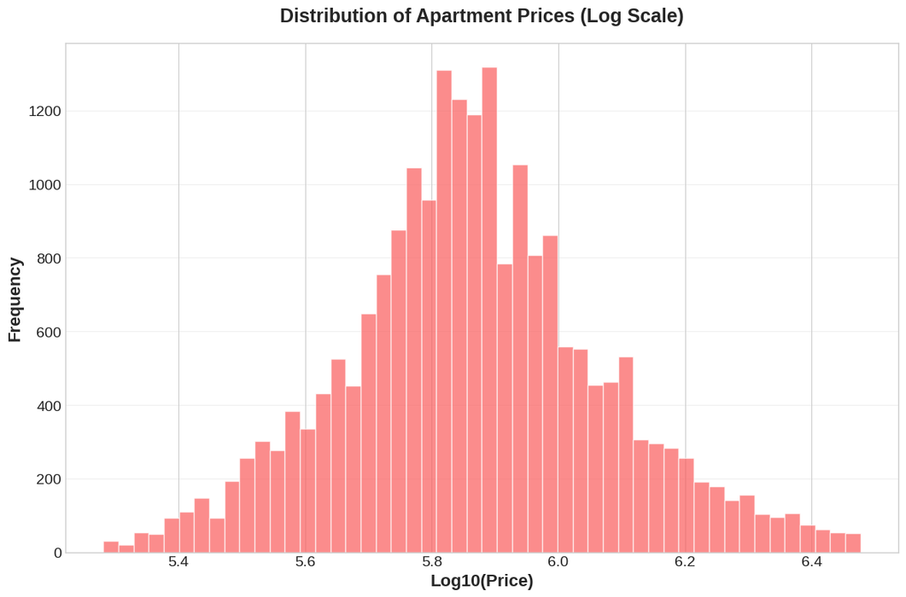
Price Distribution

Slide 9
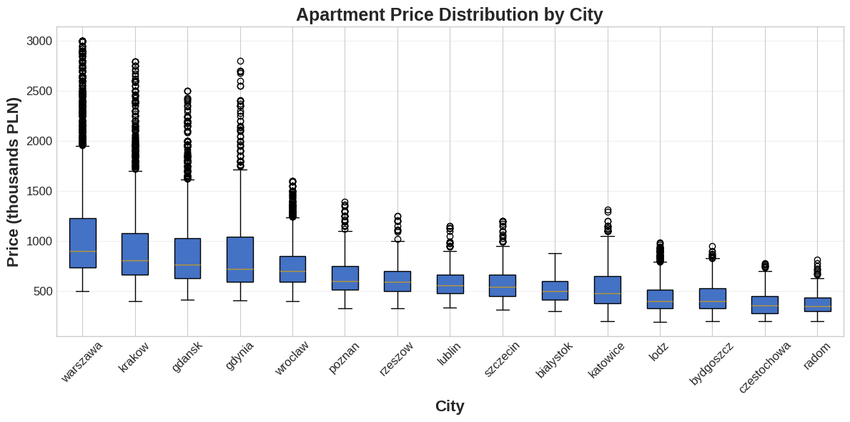
Price Variation by City
  Highest prices: Warszawa, Kraków, Gdańsk, Gdynia
  Lowest prices: Radom, Częstochowa, Bydgoszcz

Slide 10
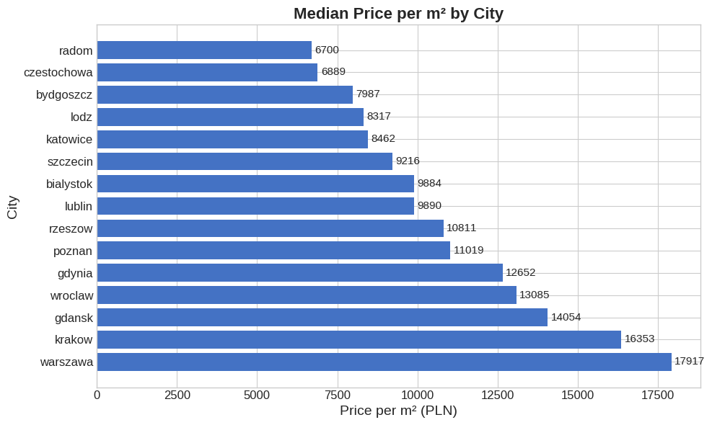
Price Variation by City
  Price per m² range: 6,700 PLN/m² (Radom) to 17,917 PLN/m² (Warszawa)
  Clear regional differences → Suitable for MANOVA analysis

Slide 11
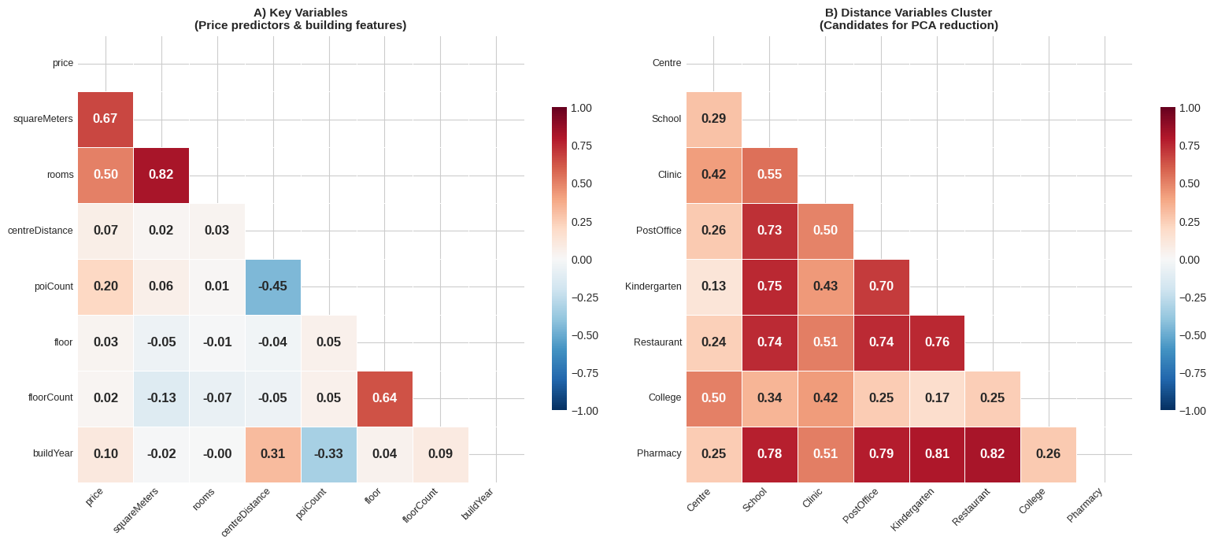
Correlation Structure

Slide 12
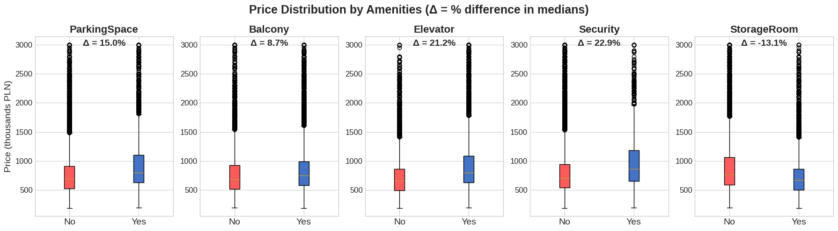
Amenities Impact on Price
  Storage room associated with older, less expensive buildings
  Binary amenity variables can be used for classification/discrimination

Slide 13
Research Questions
  How well are Polish cities positioned in terms of infrastructure?
  How do apartments with amenities differ from those without?
  Are there natural groupings/segments in the Polish apartment market?
  Do apartment characteristics (size, price, distances) significantly differ across Polish cities?
  What are the main underlying factors (latent variables) that explain apartment characteristics?
  ...and many more!

Slide 14


Slide 15
Are important infrastructural objects close enough?
1
Warsaw apartments only (n = 6,962)
F-statistic : 24641.31
p-value < 0.001
Reject H₀
Distances to school, clinic, post office, kindergarten, restaurant, college, pharmacy
2
3
H₀: μ = (1, 1, 1, 1, 1, 1, 1)' km
4
One-Sample Hotelling's T² Test

Slide 16
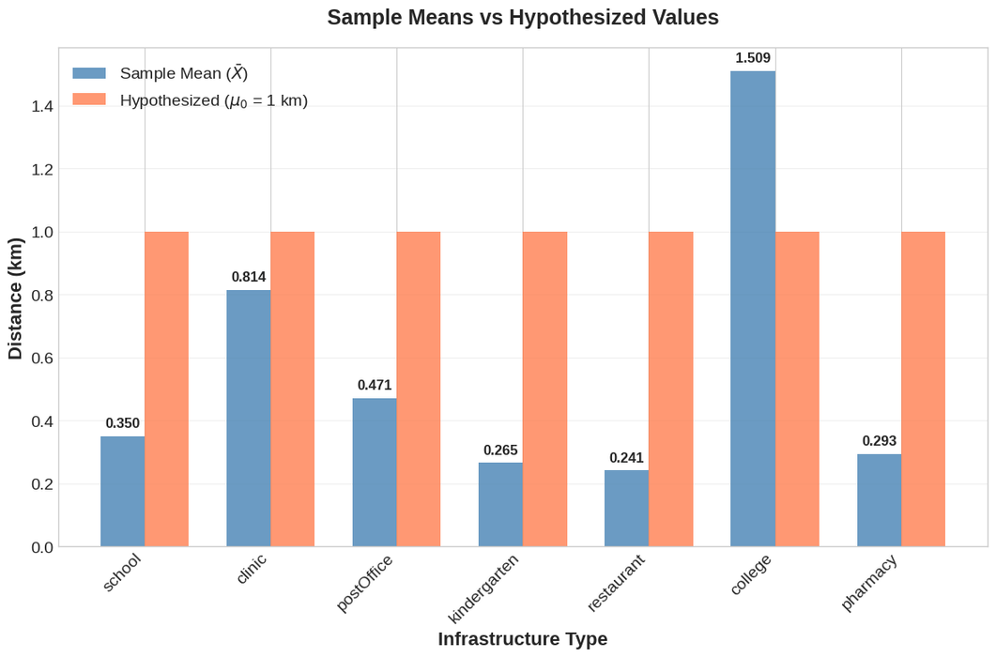
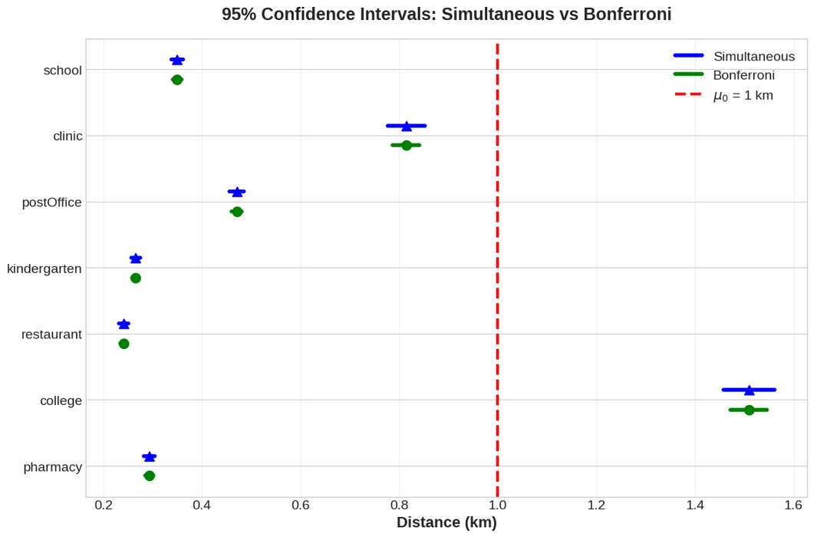

Slide 17
Are amenities actually that important?

Slide 18
Let’s figure it out!
1
Select key variables: squareMeters, price, rooms, floor, floorCount, buildYear
Divide data into groups by presense or absenses of amenities (Balcony, Parking Space, Elevator, Security, Storage Room)
2
3
Obtaine sample mean vectors
4
Compare groups using Two-sample Hotelling's T² tests

Slide 19
Hypotheses:
H₀: μ₁ = μ₂ (mean vectors are equal)
H₁: μ₁ ≠ μ₂ (mean vectors are not equal)
Sample mean vectors:
Have balcony: (58.67, 850115.60, 2.71, 3.34, 5.62, 1994.14)'
No Balcony: (54.56, 786748.11, 2.51, 3.33, 5.24, 1978.72)'
Hotelling's T² = 1882.8838
F-statistic = 313.7410
Degrees of freedom: df₁ = 6, df₂ = 21494
Critical Values (α = 0.05):
F-critical = 2.0990
P-value: 1.110223e-16
Comparison | F-statistic | Decision
Balcony | 313.74 | Reject H₀
Parking | 211.53 | Reject H₀
Elevator | 2510.55 | Reject H₀
Security | 173.25 | Reject H₀
Storage | 645.86 | Reject H₀

Slide 20
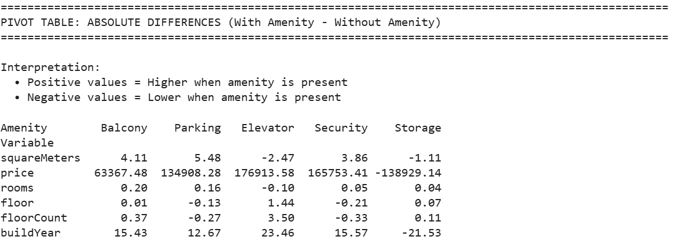

Slide 21
How different are housing markets of three biggest cities?

Slide 22
- squareMeters
- price
- rooms
- floor
- floorCount
- buildYear
Hypotheses:
H₀: μ_Warsaw = μ_Krakow = μ_Wroclaw
H₁: At least one differs
Warsaw
vs
Krakow
vs
Wroclaw
g = 3
p = 6
n_1 = 6962
n_2 = 3245
n_3 = 2271
Reject H₀
Cities are different
Obtained
x̄_1,
x̄_2,
x̄_3
F-statistic = 252.9693
df₁ = 12,
df₂ = 24941.0

Slide 23
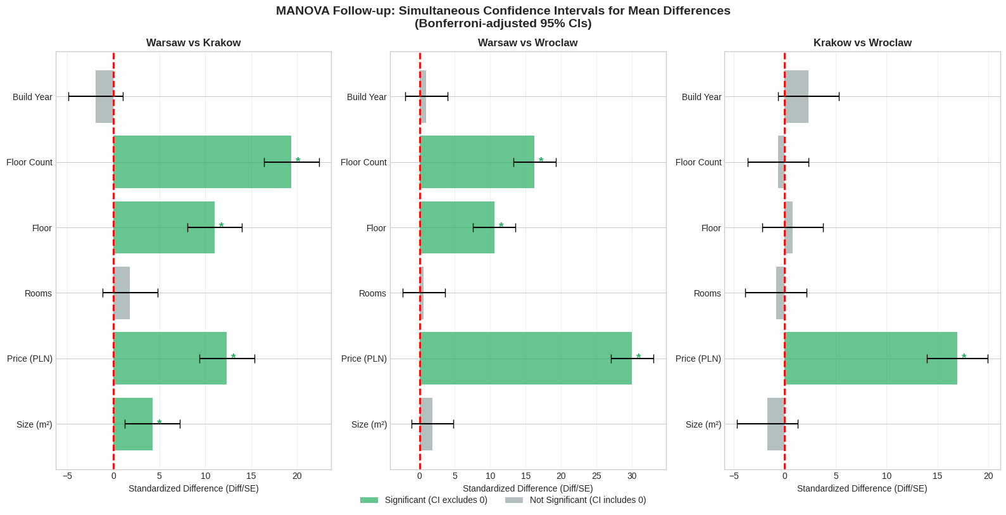
Why are they different?

Slide 24
Insights
Warsaw apartments are the most expensive (avg. 1,050K PLN) and are in tallest buildings (avg. 6.4 floors)
Wroclaw has the lowest average prices (746K PLN)
No difference in average number of rooms and a year built

Slide 25
Principal Components Analysis
and
Principal Components Regression

Slide 26
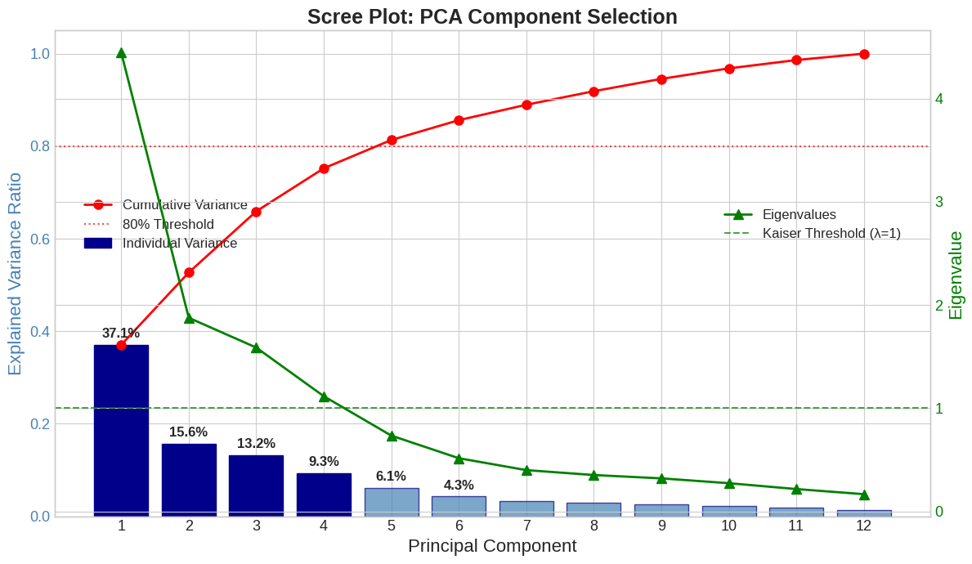
Motivation
  Problem: High correlations among distance variables
  Solution: PCA reduces 12 correlated features → 4 uncorrelated components

Slide 27
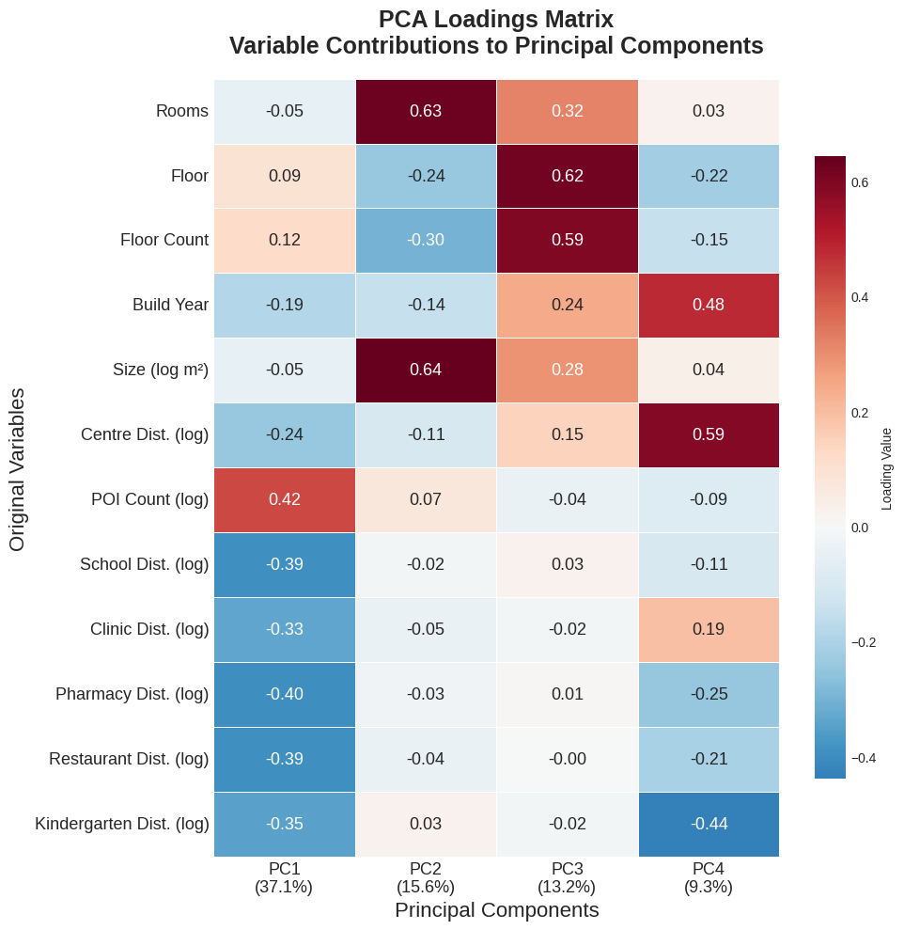
Components
  Total variance explained: 75.21%
  PC1 (37.1%): Location Quality
  PC2 (15.6%): Apartment Size
  PC3 (13.2%): Building Height
  PC4 (9.3%): Suburbanization Pattern

Slide 28
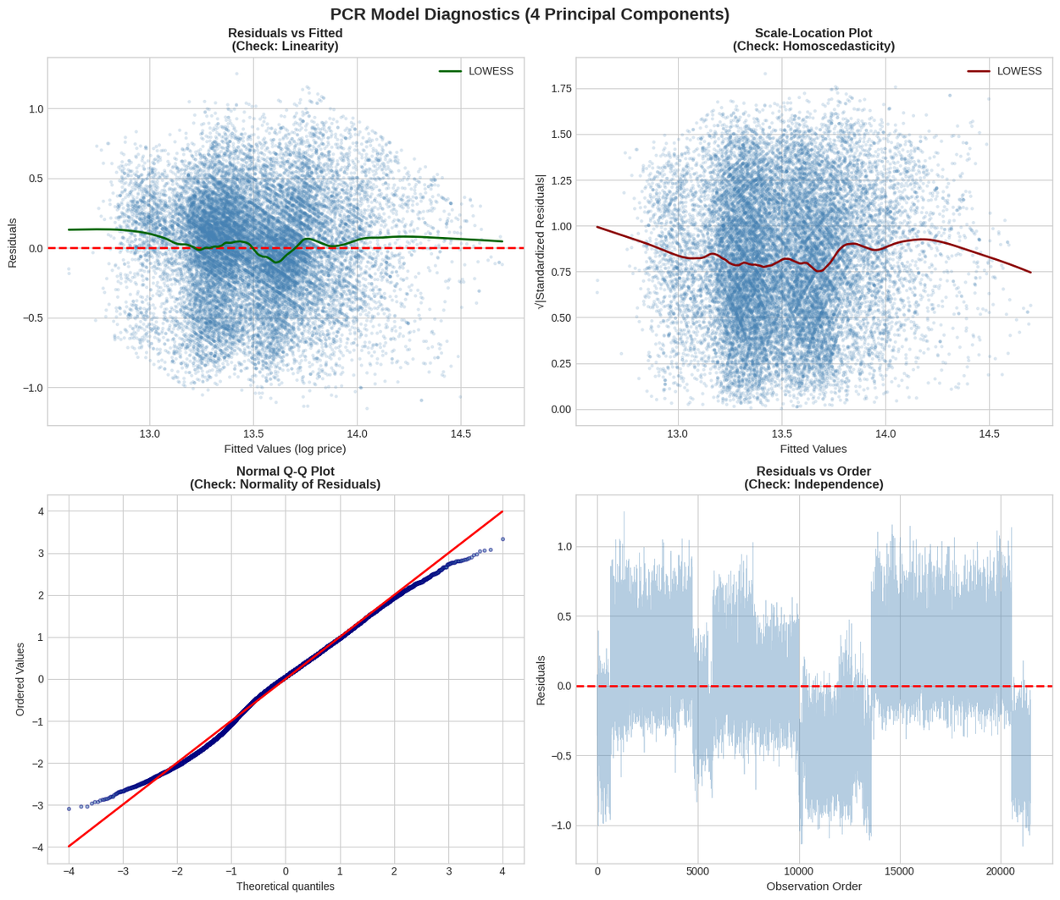
Principal Components Regression
  Model: log(price) ~ PC1 + PC2 + PC3 + PC4
  All components statistically significant (p < 0.05)
  R-squared: 0.3754

Slide 29
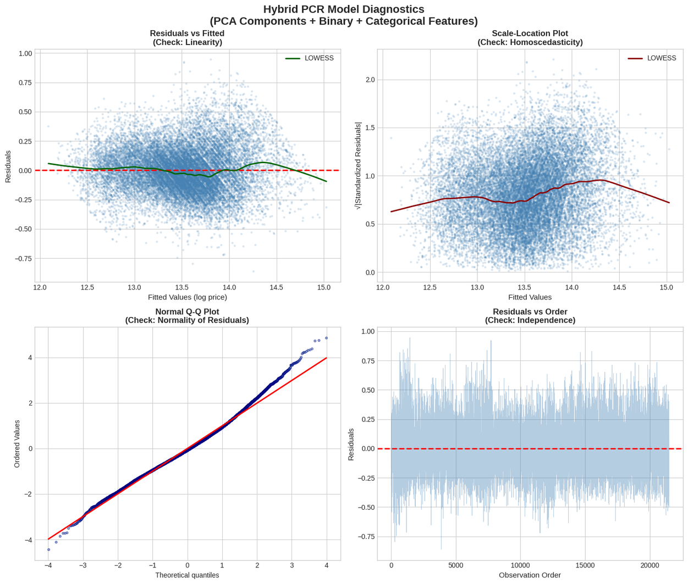
Hybrid PCR Model
  Model: log(price) ~ PC1 + PC2 + PC3 + PC4 + Binary + Categorical
  Features: 4 PCs + 5 binary + 23 dummies = 32 total
  Model is statistically significant (p < 0.05)
  R-squared: 0.831

Slide 30
Factor Analysis

Slide 31
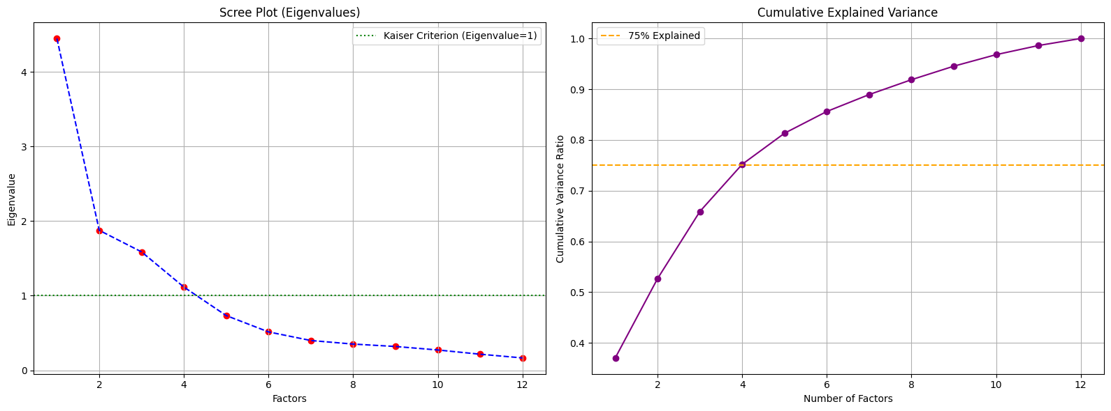
How many factors to keep?
There are 4 factors with eigenvalues > 1
Those factors are responcible for 75% variance of the data

Slide 32
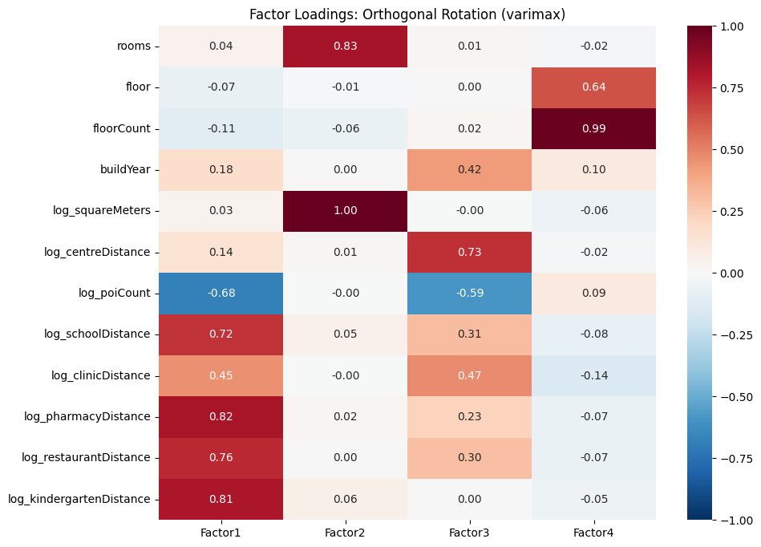
Varimax
  F1 : Location Quality
  F2: Apartment Size
  F3: Suburbanization Pattern
  F4: Building Height
Factor loading are similar to PC due to high communalities

Slide 33
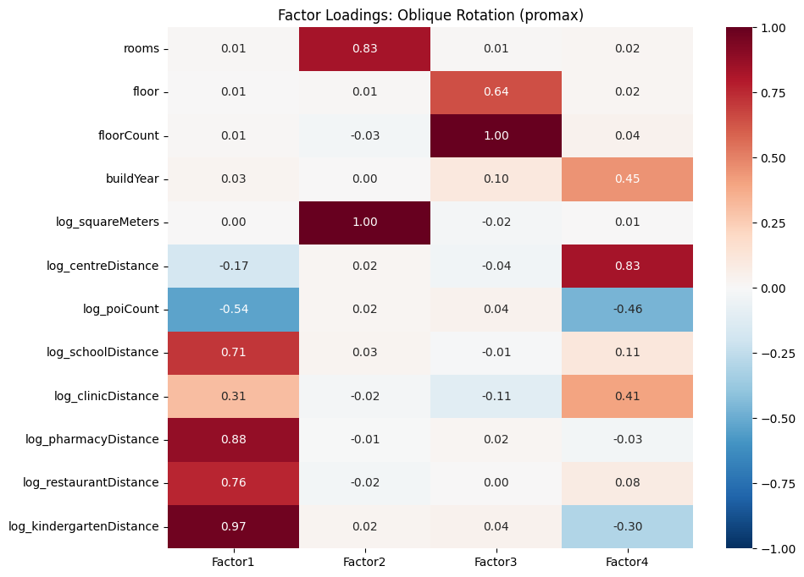
Promax
  F1 : Location Quality
  F2: Apartment Size
  F3: Building Height
  F4: Suburbanization Pattern
The loadings are different but the same structure persists

Slide 34
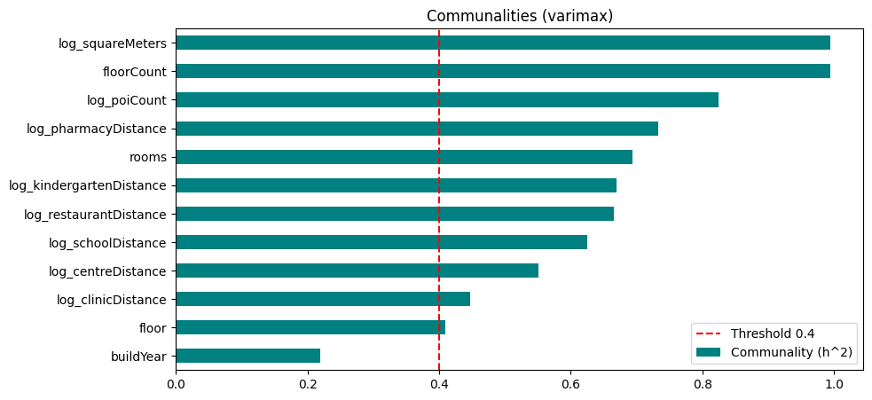
Communalities (Varimax)
The spaciousness factor is the strongest
while floor and build year have high specific variances

Slide 35
Discrimination and Classification

Slide 36
Can we effectively discriminate between high-priced and low-priced apartments in Poland based on their characteristics?
Choose the best model
Top Discriminating Features

Slide 37
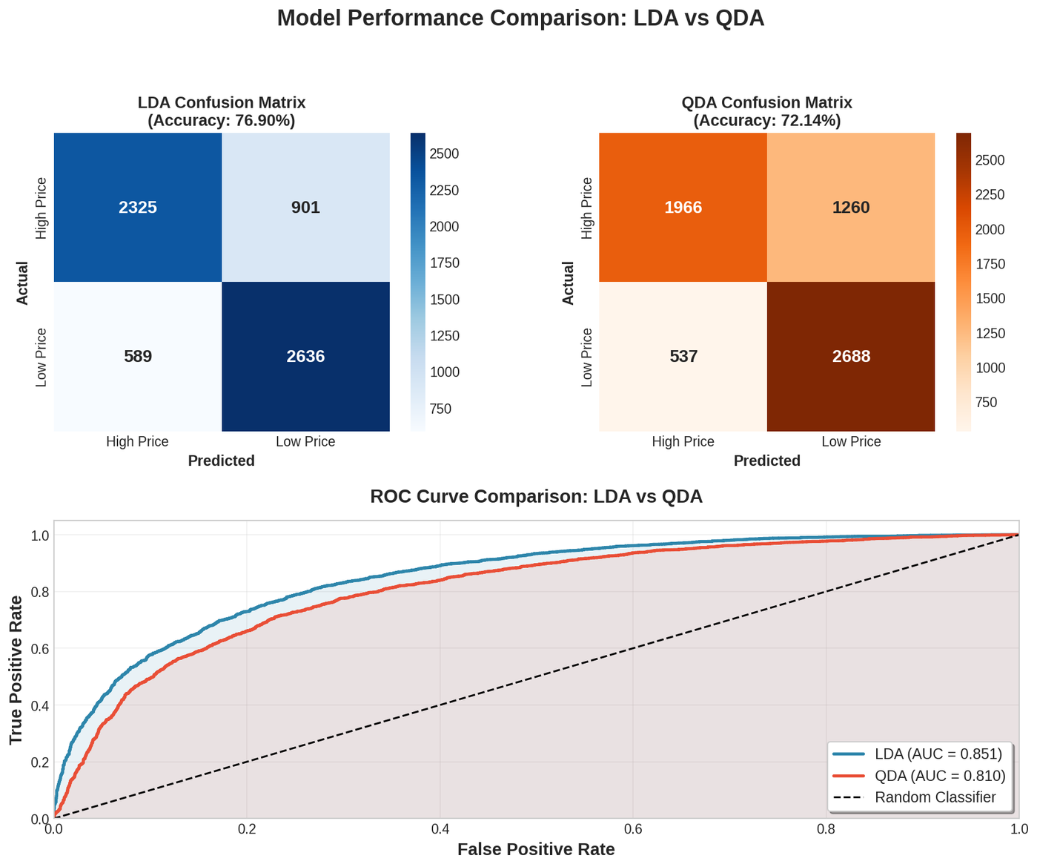
LDA VS QDA
  LDA outperforms QDA
  Equal covariance assumption is reasonably satisfied for most features

Slide 38
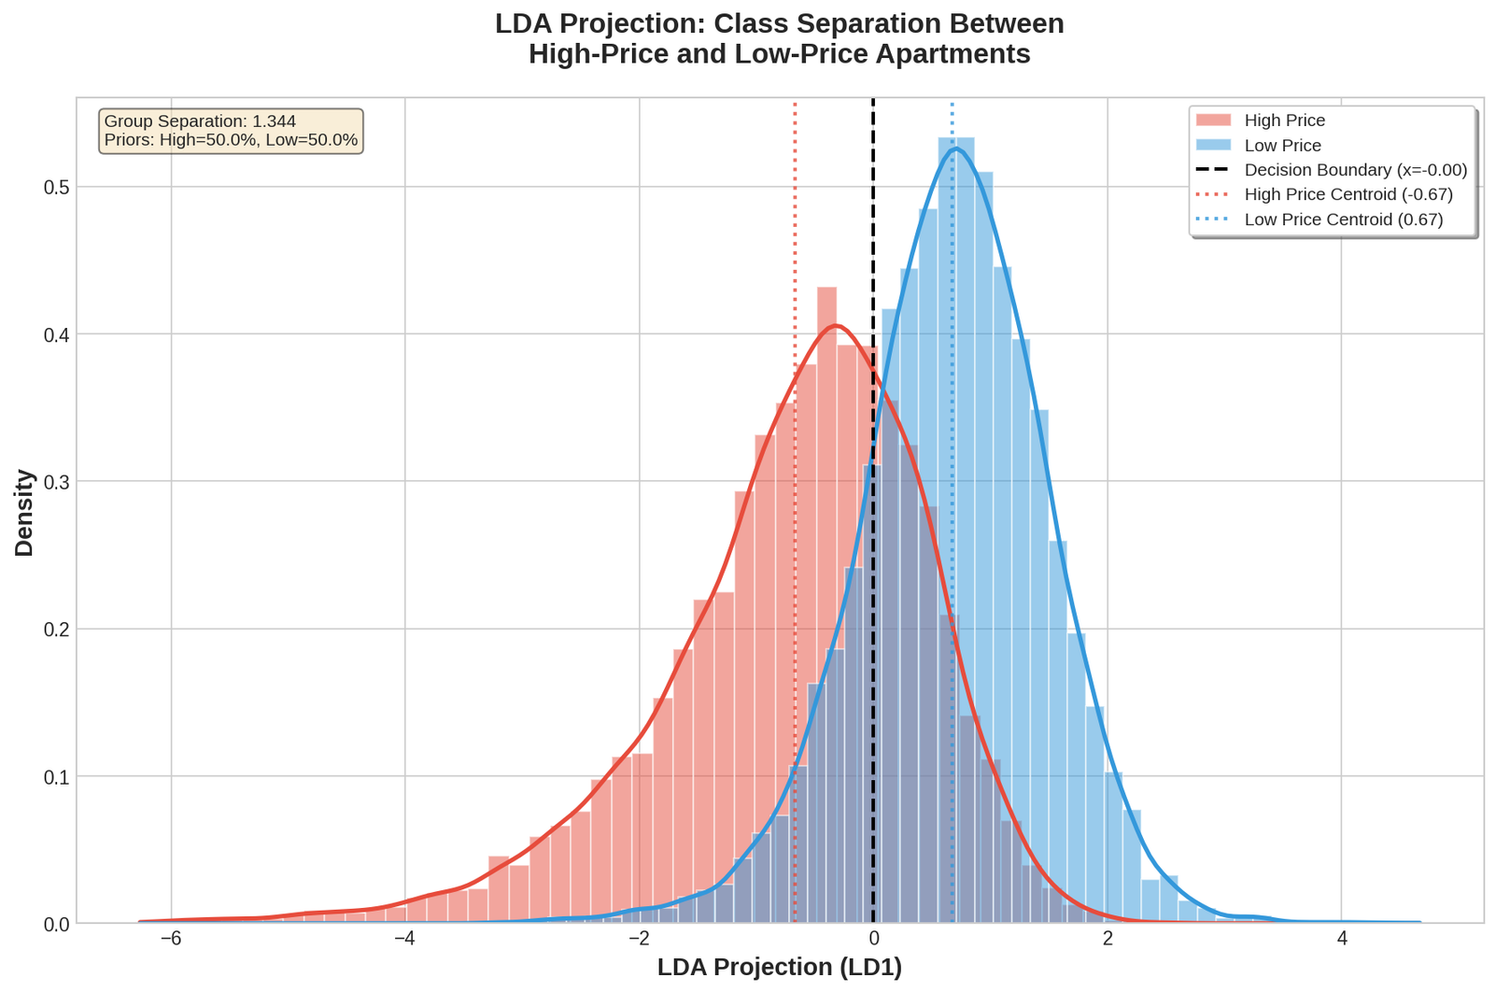
Classification rule
  Two classes: High=0, Low=1
  Classification rule in this space:
If x < 0 → Classify as High Price
If x ≥ 0 → Classify as Low Price

Slide 39
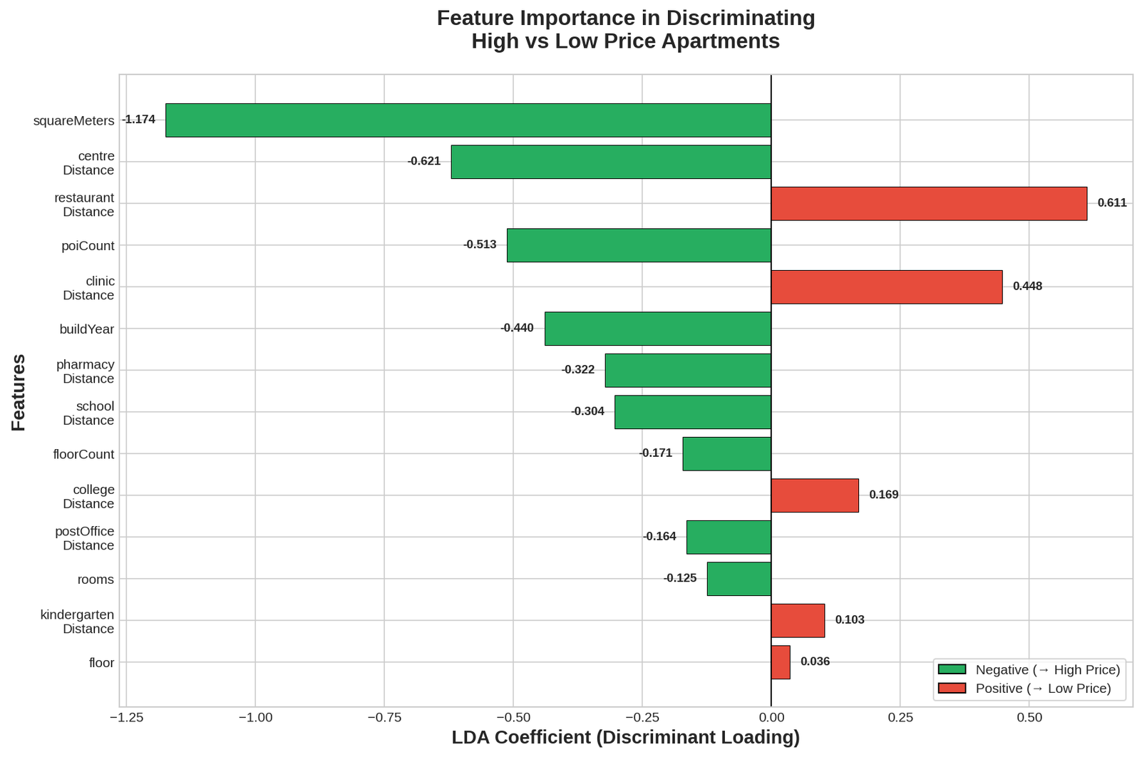
Top Discriminating Features

Slide 40
Clustering

Slide 41
Can we identify distinct market segments of apartments in the Polish real estate market?
1
Selected variables (physical characteristics, location attributes, and pricing)
2
Removed 256 outliers (1.2%) with extreme distance values
3
Clustered 21,245 apartments in k groups determined by silhouette analysis

Slide 42
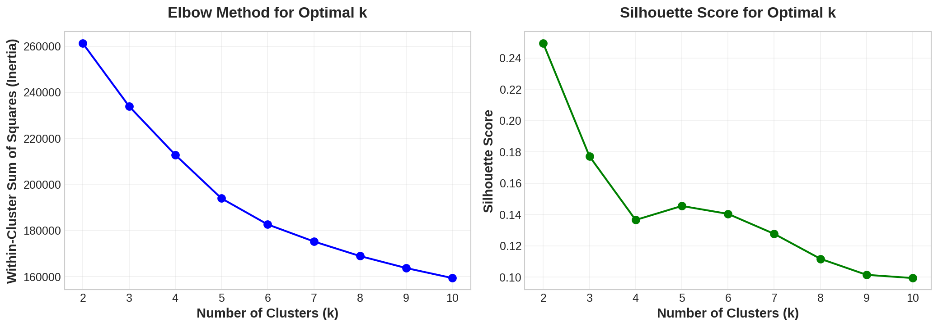
Determining optimal number of clusters

Slide 43
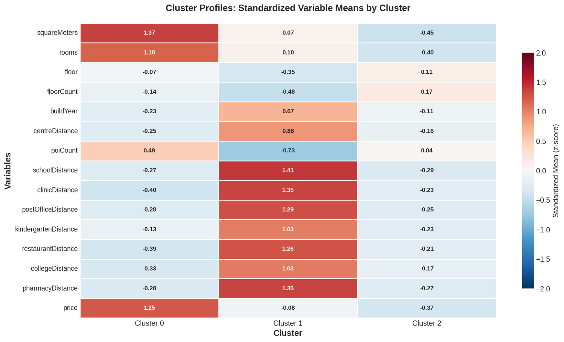
Cluster Profiling

Slide 44
Key findings
Cluster | % | Avg Price | Avg Size | Segment Name | Avg Build Year
0 | 20.0% | 1,363,809 PLN | 85.0 m² | Premium/Luxury | 1981
1 | 16.8% | 789,198 PLN | 58.3 m² | Modern Suburban | 2008
2 | 63.3% | 663,978 PLN | 47.6 m² | Standard Urban | 1984
  Cluster 0 (Premium): Largest apartments, highest price & price/m², central locations
  Cluster 1 (Suburban): Newest construction, farthest from all amenities, lowest POI count
  Cluster 2 (Standard): Smallest, most affordable, best access to urban amenities

Slide 45
Conclusion
Our multivariate analysis of the Polish real estate market (15 cities, ~21k observations) reveals a highly structured market driven by four distinct latent forces.
  Market Drivers: Through PCA and Factor Analysis, we reduced complex data into 4 key dimensions that define the market: Location Quality (infrastructure access), Apartment Size, Building Height, and Suburbanization Patterns.
  Valuation Factors: The Hybrid PCR Model proved highly effective, explaining 83.1% of price variance. The most critical discriminators between high-end and low-end properties are size, distance to the center, and proximity to restaurants.
  The "Amenity Premium": Modern amenities significantly impact valuation. Features like security and elevators command price premiums of 21-23%, whereas storage rooms are associated with lower-value, older stock.
  Market Segmentation: Clustering identified three natural market segments: Standard Urban (63%), Modern Suburban (17%), Premium/Luxury (20%)
  Regional Disparities: There are statistically significant differences between major metropolises, with Warsaw standing out as a distinct market characterized by significantly higher prices and taller vertical development compared to Kraków or Wrocław.

Slide 46
The End
THANK YOU FOR LISTENING

Slide 47
References
  Johnson, R. A., & Wichern, D. W. (2007). Applied Multivariate Statistical Analysis (6th ed.). Pearson Education Press. ISBN: 1-292-02494-1.
  Rencher, A. C., & Christensen, W. F. (2012). Methods of Multivariate Analysis (3rd ed.). Wiley. ISBN: 978-0-470-17896-6.
  Dataset (Source): 3. Jamroz, K. (2024). Apartment Prices in Poland: Pricing of apartments in 15 largest polish cities [Data set]. Kaggle. Retrieved from https://www.kaggle.com/datasets/krzysztofjamroz/apartment-prices-in-poland

